Slide 1
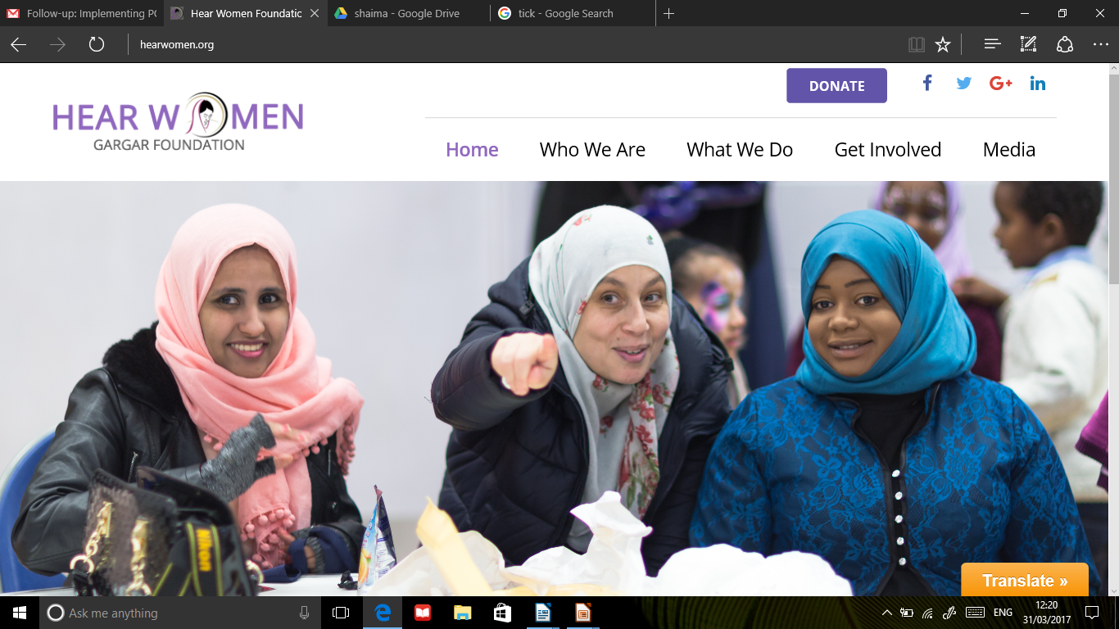
Know Your Health project
FUNDED BY WLCCG

Slide 2
Who We are Hear Women
Hear Women is a none profit organisation with aim to eradicate gender based inequality and discrimination and empowering women of all ages to realise their full potential.
We work with Women & Girls from East and North Africa to enable them to reach their full potential and we advocate the following
Improve Women’s Health & Well being
Advocate Against Gender Based Violence
Enable women to be in charge of their livelihood

Slide 3
Know How Health
WLCCG 2016-17
The aim of the project is to bringing together the expertise and local people and professionals to champion and drive high quality health and well-being for all community and overcome health inequalities”
The project is primarily aimed at BME families, especially women, from the African and Arabic Communities who live in North Kensington and North Westminster, specifically in and around Golborne, Westbourne and Harrow Road, and Queens Park area .We target people who struggle to access mainstream health services; the majority of these are people with low income, for whom English is not their first language
We worked with the following centers and schools so fare
Hallfield Primary School (Westminster)
Bevington Primary School ( Golborne, RBKS)
Al Manaar Muslim Cultural Center ( RBKC)
Stow Community Center (Westminster)
Wilberforce Primary School (Westminster)

Slide 4
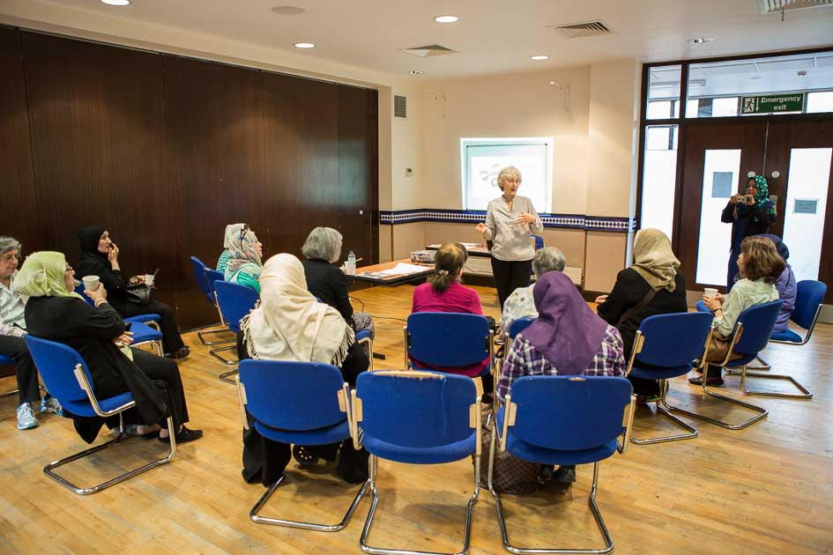
Parents Coffee Morning

Slide 5
Happiness Corner
Aim: It is to learn about the science of wellbeing. How important is to embrace ‘’here and now’’. To enjoy the moment. How to reduce anxiety thinking about the past (primarily mistakes) and the future (doubts). Learn to be grateful. Feeling engaged and related to others rather than being disconnected.
How being positive can help our life to shine.
Each session will have a 5/7 minutes of mindfulness exercise towards the end
Each session will have a theme featuring for example:
Mental Health: The other side of the coin
Happiness - Positive Emotions
Engagement – Relationships
Meaning & Purpose
Accomplishment
Mindfulness
Talking sessions
Mental Health First Aid
Case study: I have attended two sessions in mental health related talk and I have learned new information and really I was happy that I have attended these sessions. Because this can affect anybody, anyone could have mental health issues in different ways such as stress depression. -Amira Fatah

Slide 6
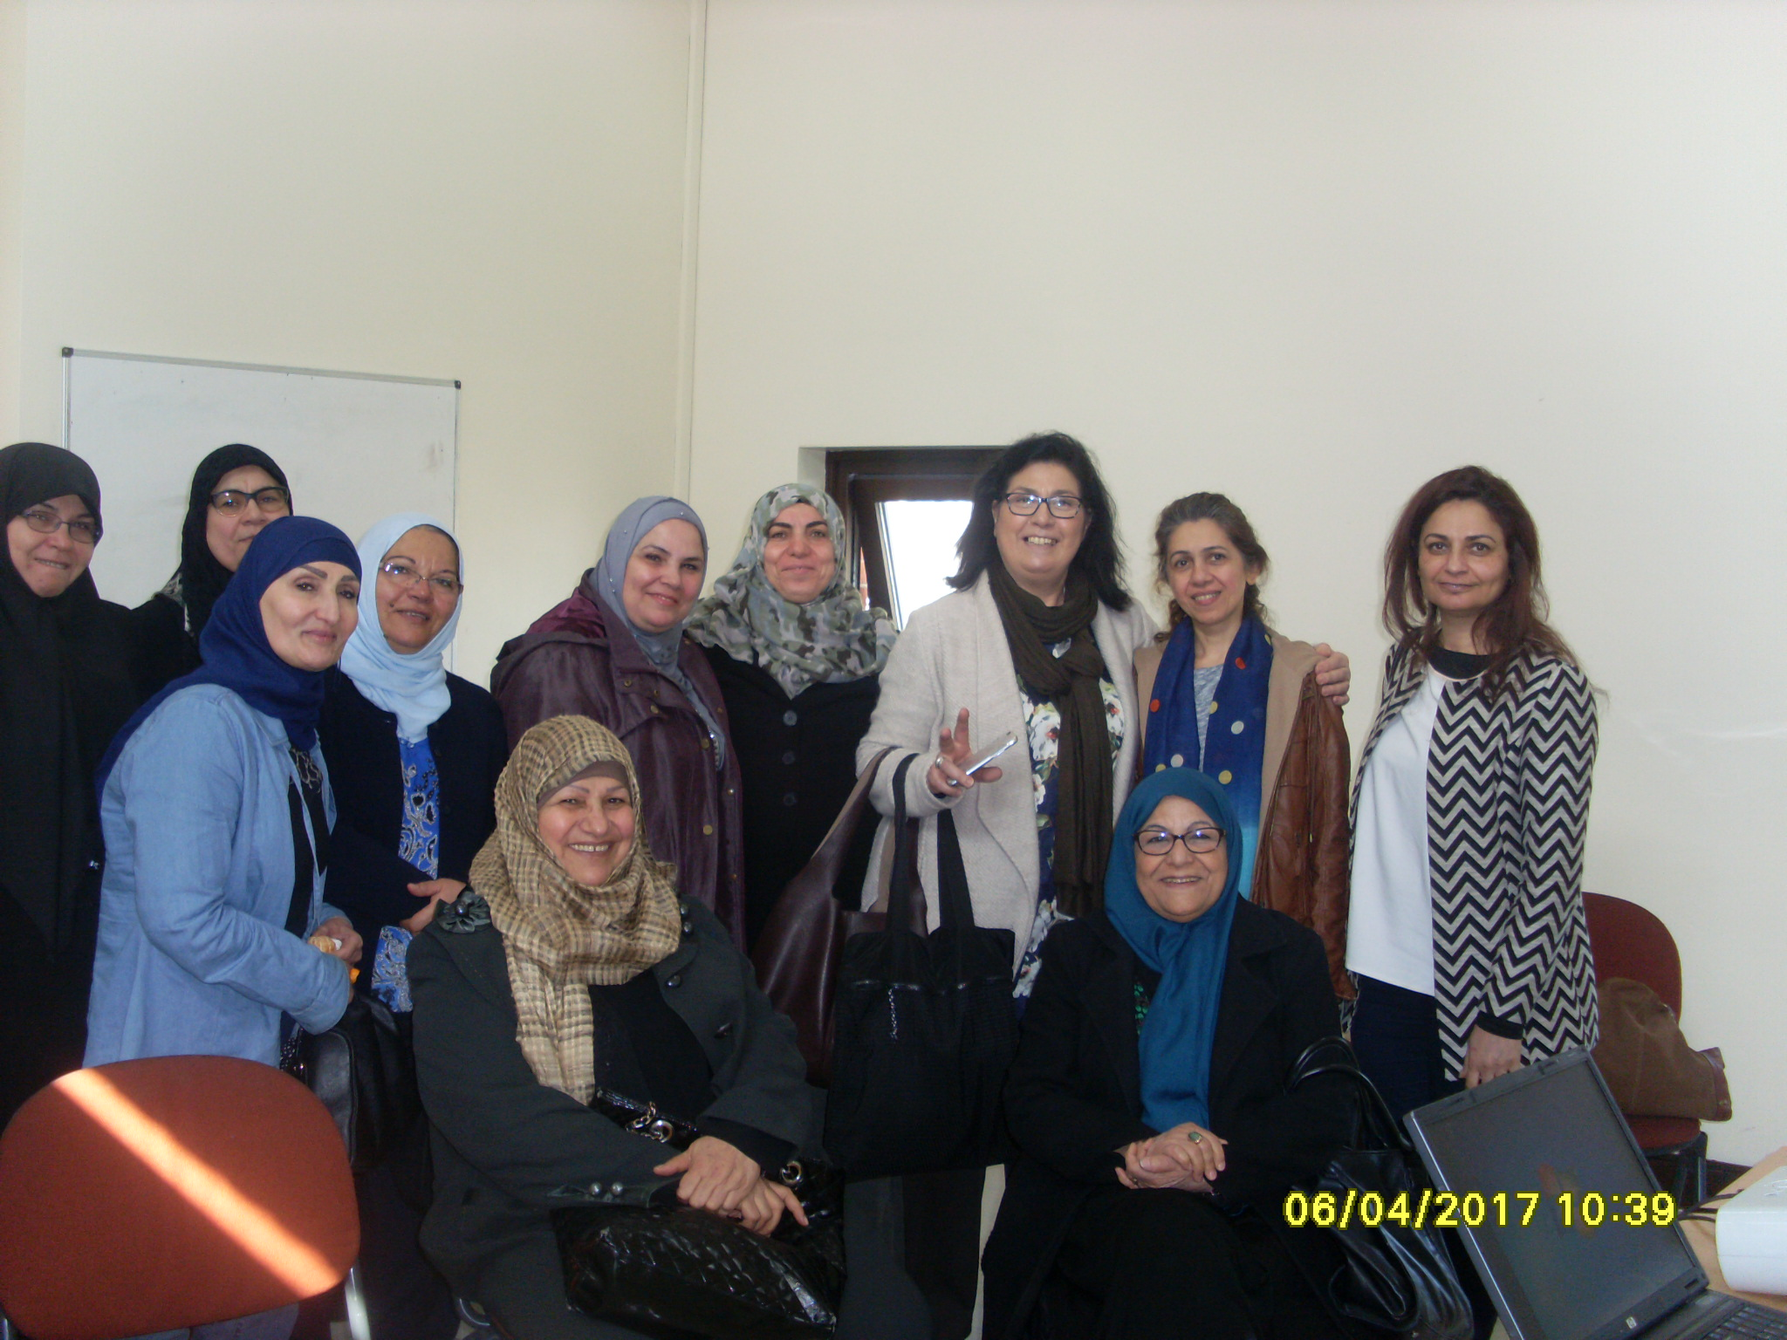

Slide 7
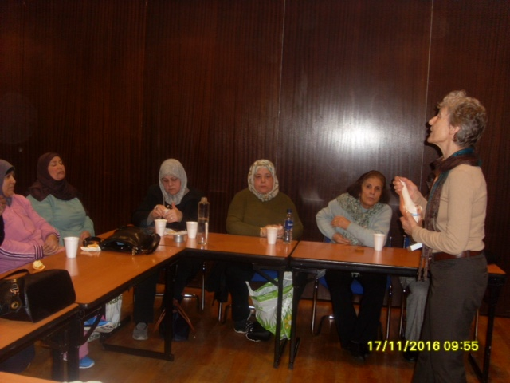

Slide 8
BME representation on local PPGs
Hear Women, in collaboration with Health watch, identify eight local GP Practices lacking BME representation, and recruit so fare 15 women and 5 men to become active PPG members for the identified practices.
Target: 8 GP practices both Westminster and RBKC , 10 women and 5 men to be registered
Timeline: October 2016 – June 2017
Case study: On the 9th of Dec 2016 I was introduced to a programme called PPG (patient participation group) I was also informed that being part of my GP PPG group this will help me to lerarn new skills and also to provide patients feed back about what is good or not good about their local GP ; since I joined I was able to meet new people , I listen to patients stories and views about the GP , I explore ideas and suggestions on how to improve patients experiences in the GP practice, at the moment I am running small projects around patients education, health promotion and improvements. - Wijdan

