Slide 1
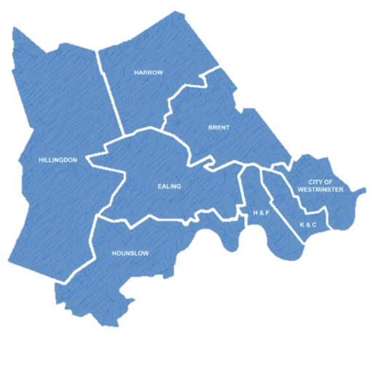
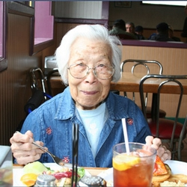
Whole Systems Integrated Care Earls Court & Chelsea Forum 23rd October 2014
“I want my care to be coordinated and not to feel afraid”
COMPREHENSIVE & COMPASSIONATE CARE

Slide 2
Whole Systems
Norman Lamb, Health Minister, set an ambition to the whole system integrated by 2017. This includes:
GP
Community care
Hospital and outpatient services
Mental Service
Social care
Break the ‘rules’, be creative and have the difficult conversations
14 Whole Systems Pioneers were appointed nationally
North West London (NWL) bid to be and were appointed as a Whole System Pioneer
Within NWL there are 10 pilots
West London CCG is one of those 10 pilots

Slide 3
The West London Whole Systems vision is based on a number of core agreed principles
Core underlying principles on which there is broad alignment
The patients covered will include all above 75s registered with practices that are part of WLCCG
The model of care should cover their integrated health and social care needs and all medical conditions and all types of services – proactive, reactive, acute, mental health etc.
The model of care would have the patient at the centre, with empowering them and their carers for self-care and self-management being a critical component
Care will primarily be community based, with Primary Care leading and provided through integrated multi-disciplinary teams working together, and following a planned approach to care
The objective of the model is to make a material difference in care outcomes, quality and experience for 75+ - specifically to
Provide 24x7 access to primary care led clinical decision making support
Provide easy to use single point of access and coordination for wider services in the community including step up and step down from acute
Easier and wider access to diagnostics and other support services in the community
Ultimately make them feel safe and their care feel more coordinated
The transition from the current care model to the new should have broad support from all concerned providers and be planned to take into account the implications for staff , systems, funding flows and various existing schemes such as PPF, BCF, CIS etc.

Slide 4
We are committed to co-design and have already listened
Smooth transfer between services
Co-location of services
Support patients to maximise their own health
Longer GP appointments
Better care planning!
Sharing of information
Calm
Listened to
Services provided at / close to home
Notes:
“We are committed to working collaboratively to improve the patient experience of integrated care, admission to and transition from hospital. We intend to co-produce an integrated approach to the care of the population aged over 75 in the participating GP practices. We intend to co-design with patients, carers and service providers a personalised model of self-care which puts the patient/carers at the centre of a coordinated communication and service delivery process in relation to the management of their long term condition(s). ”

Slide 5
The proposed model of care (so far)…
Single, personalised and shared care plan
Named GP
Home
Integrated health and social care workers, primary care navigators
GP practice
Increasing needs
Care network
Case manager (could be from health or social care)
Single SPA for joint health & social needs
Health centre/Hub
Patients & their
carers / family
CIS case manager
Major hospital
Is holistic & supports both medical and social wellbeing
Is proactive, personalised, preventive and empowering
Is simpler and easier to access across your health and social needs
Always has clear point of accountability with a core team that reflects your needs
Is available 24x7 at a location most suitable to your needs
Is safer, more responsive, and compassionate

Slide 6
Patient feedback so far …
The community hubs are currently being designed
Patients suggest…
Single hub good idea and should feel like a village
North and South need a hub
Should provide for social and wellbeing needs not just medical needs
Good transport links/parking (or provide transport), be near, be able to offer multiple appointments on the same day at same location
Could include , community health, voluntary services and other therapists but also wellbeing and social activities/services
Services should include reactive and proactive:
GPs
Health checks
Diagnostics
Step-up and step down
Drop ins
Specialist services – including specialist older persons nurses
Voluntary sector
Other services could include:
Blood tests
Dentist
Diabetes – (one group suggested these are perhaps in separate hubs of excellence - Blood tests, dieticians, vascular, psychotherapy, exercise)
Eye test/opticians
Exercise
Hearing
Hydrotherapy
Massage
Mental health advice/psychological services
Pharmacist
Physio
Podiatry
Social Activity – Tea dances, crochet, lunches, gardening, music, day trips, bridge, CAB
X-ray

