Slide 1

Cost of Living Crisis

Slide 2
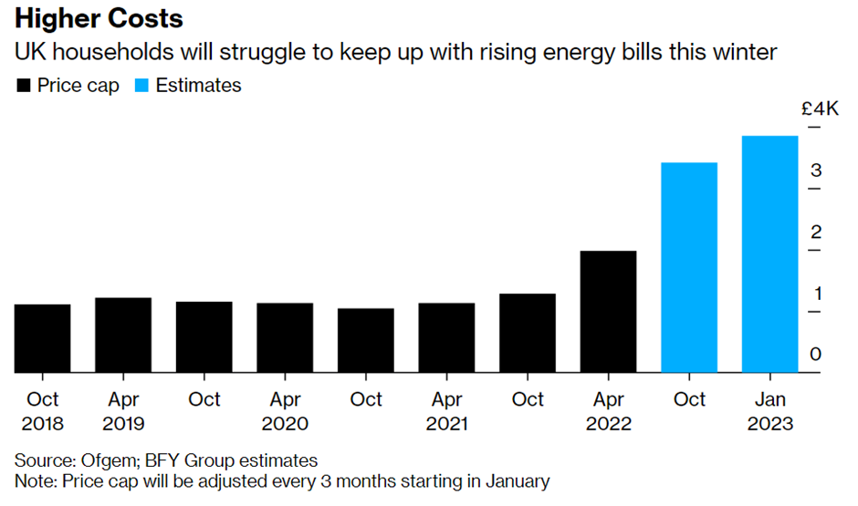

Slide 3
Government Support
£150 rebate for people of A-D Council tax band
£400 for everyone – off bills credited to utility bills ie £63 pcm for 6 months
£650 for people on mean tested benefits : £326 paid into bank accounts in Late July another payments of £324 due “soon”
£150 for people on disability benefits ( not ESA)
£300 for pensioners ( on top of Winter Fuel Payment 200-300)
plus any of the above that apply

Slide 4
The Government Cap
The new price guarantee starts 1 October, and for someone on typical use will be £2,500 a year and will last for two years.
The current price cap is £1,971 a year rate at typical use, and was due to rise to £3,549 a year (and likely £5,400 a year in January). It was £1,277 a year last winter.
Cap on standing charges and unit rates, so use less you pay less, use more you pay more There is no total cap on what you pay, the typical rate is just a figure for illustration.
The £400 payment to all homes (paid as £66 a month over winter) will continue. That will take the average payment to £2,100 a year.
To estimate what you’ll pay, over a year, multiply current costs by 6.5%
(each £100 becomes £106.50). This includes the £400 discount (but not
other payments).

Slide 5
KC Foundation Winter Warmth Project
We have been a member of KC Foundation Winter Warmth Project for over 10 years.
KC foundation campaign target better-off pensioner to donate their winter warmth grant to the project. The project used these funds to make grants to less well of residents, targeting residents who were sick, reaching retirement age , on means tested benefits and/or living in damp or badly insulated property
This year KC foundation approached Julia and Hans Rausing Trust and launched a project in December (2021) to make fuel grants upto £1k to help clear arrears of people : The idea was to help / intervene quickly and help longer term with advice.
Needless to say price increases since Dec 2021 have overtaken events. The ½ million donated is just not enough.

Slide 6
What can you do
Work together - act quickly and early
Over 20 % of ALL consumers in arrears
What will we do
Debt/ housing ( in mortgage) advice - avoid disconnection and eviction
Breathing Space ( 60/30 days)
Trustfolio credit checks
Grants
Re opening referrals soon (10.10.22) https://www.nucleus.org.uk/contact

