Slide 1
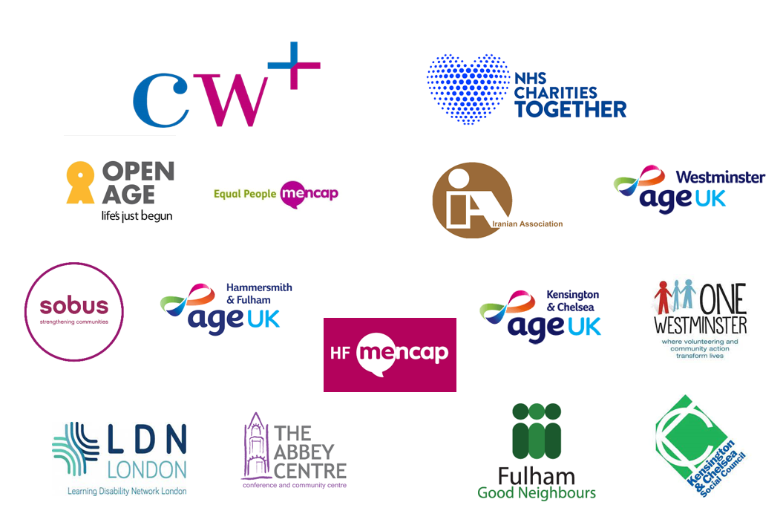
Niall Reilly
DigitALL Project Coordinator

Slide 2
What is DigitALL?
We know that health, wellbeing, welfare and community services are increasingly operating on-line
This is of particular concern as Older Adults and Adults with Learning Disabilities are amongst the highest users of health and social care services, and are some of the most digitally excluded groups.
DigitALL looks to work with these excluded groups to ensure that they are supported to access these kinds of services now and in the future. They will also be able to learn a range of skills based on their needs and interests

Slide 3
What do we provide?
An in-depth assessment (DART) with all prospective participants to understand what they need from us, their level of confidence and what interests them
Access
Connectivity
Experience
Destination

Slide 4
Purpose of the DART
Conversation not questionnaire
Build a project around needs, focusing on what a participant wants and not what they know.
Focus on learner checklist as learning opportunities, not as a baseline to understand knowledge
Sets a measureable outcome, also tries to focus on the why?
Gives us an opportunity to identify appropriate device, organization etc
Exit DART revisits the tool to monitor progress and signpost future development

Slide 5
What do we provide?
We use the responses to devise a bespoke pathway for each participant. This includes:

Slide 6
DEVICES AND DATA: Providing devices and connectivity we will reduce financial barriers to access
We provide loaned devices and free data to participants who need it. We can provide them with a device best suited to them, and can configure the device to suit individual needs

Slide 7
DEDICATED SUPPORT: Providing either 1:1 or group training as appropriate and on-going support we will reduce barriers related to , skills, knowledge and confidence
Support is centred around their interests, and the participant opts for the type of support that best suits them e.g whether they want a group class or one-to-one support
We offer outreach support to house-bound participants
Because of the partnership model, we can offer real flexibility to our participants as there is a range of support they can access

Slide 8
The DigitALL Journey
Mario (83) is partially sighted and has felt nervous at joining a class due to his perceived disadvantage. He has never owned a tablet as he’s worried he won’t be able to see it.
Through DigitALL, David has received a tablet which has been configured by RNIB and a sim card. He has attended 5 one-on-one sessions with a tutor and has graduated with the project. He will begin a 5 week ‘Continuing with the Tablet’ course at Open Age

Slide 9
He will be joined by John (68), who also received a new tablet. John had a chronic back injury which meant he was visited by a tutor for four one-on-one sessions. Since recovering from the injury, we have been able to provide transport for him so he will be able to attend the course.

Slide 10
Amandeep (53) and her mother Qamile (81) have never been confident enough to develop online skills as they both speak very little English. Through DigitALL they have both been provided with tablets and attend sessions together with a Farsi speaking tutor. They are hoping to improve their English skills by installing a language app and using Google assistant on the tablet

Slide 11
Strengths of the Partnership
The flexibility we are working with enables us to support a real range of people across the tri-borough
This ensures we are reaching the most digitally excluded individuals and supporting them comprehensively

Slide 12
25% of participants are Iranian
28.5% of participants are Black British, African, Caribbean or other Black Background
12.5% have an Asian Background

Slide 13
Is English your First Language?

Slide 14
Do you have any disabilities or health issues?
15 percent have a disability that affects their mobility
7.5 percent have a mental health difficulty
9 percent have visual impairments
66 percent have a health issue that requires medication
12.5 percent have dyslexia

Slide 15
Diversity of Circumstance
The project includes:
Carers
Older Adults and ALD’s looking for employment
Older Adults with long term health issues looking to book appointments, download NHS App
Adults who speak no English
Mothers and Daughter, Best Friends Learning together

Slide 17
How to Refer
The Referral Form for the project can be found here: https://forms.gle/pp3MCc6G8TrJKr2v6
Alternatively you can contact me at:
07570428756
nreilly@openage.org.uk
Niall Reilly
DigitALL Project Coordinator

