Slide 1
Covid-19 Test & Trace What is it & what does it mean for me? Lesley Derry, Community Champions Programme Manager, Public Health Carrie Hirst, Engagement & Partnership Manager, West London CCG

Slide 2
Today’s session
What is test & trace?
Antibody & swab tests
How can you:
- get a test
- take the test
- get the results
What happens when you get the results?
Scams, rumours & concerns
Where can you go if you need more information?

Slide 3
What are the tests for?

Slide 5
NHS Test and Trace
Helps to monitor & control the spread of Covid-19 by:
Providing free swab tests to all adults & children
Keeping a record of people who have tested positive
Enabling people who test positive to provide details of those they’ve been in close contact with
Tracing those contacts to find out if they have any Covid-19 symptoms and provide advice & guidance on next steps
Monitoring the number of people infected and their close contacts

Slide 6
The aim
To save lives & reduce the ‘R’ rate
The ‘R’ rate (the rate of reproduction) shows the average number of people one infected person could pass the virus on to, and is the way scientists rate a disease's ability to spread e.g R3 means 1 person can spread the virus on to 3 people
The lower the number, the less people get infected
When we experience symptoms and self-isolate we help to keep the ‘R’ rate below 1 (which is good!)
The more people do this, the more it helps to reduce the virus spreading
The ‘R’ rate will slowly become less & less
Covid-19 will eventually go away!

Slide 7
What’s the difference between an antibody test & a swab test?

Slide 8
Swab test
What is it? Cotton bud used to swab your nose & throat
Available to: Everyone
Answers the question: “Do I have covid-19?”
Antibody test
What is it? Blood test
Available to: NHS & social care staff, hospital patients & care home residents
Answers the question: “Have I had covid-19?”
Antibody tests are currently not accurate enough so the Government is not offering them out wider - there are plans to do so in the future when more accurate tests are available

Slide 9
How can you get a swab test?

Slide 11
How do you take the home test?
Use the test kit provided
Take a swab inside the back of your throat & nose
You can do it yourself or ask another person in your house to help
Video demonstrations here & here

Slide 12
How do you get the results?

Slide 13
*Close contact:
Face-to-face contact with someone less than 1 metre away
Spending more than 15 minutes within 2 metres of someone
Travelling in a car or other small vehicle with someone

Slide 14
What do you do if you receive a positive result?

Slide 16
You will be contacted by:
Phone from 0300 013 5000
Text message from ‘NHS’
E-mail asking to sign in to the official contact tracing website

Slide 17
What will they ask?
Your details | Close contact’s details
Your full name Date of birth NHS Number Postcode and house number Telephone number/ e-mail address Covid-19 symptoms, including when they started and their nature Contact details of anyone you have been in close contact with Why share? To identify and alert others who may be at risk of developing infection, and unknowingly spreading it. | Their full name Date of birth Details of any Covid-19 symptoms they may have had Why share? For the contact tracers to provide advice on self-isolation and how to protect themselves and others from Covid-19.

Slide 18
How do you know its not a scam?
Contact tracers will never:
Ask you to dial a premium rate number (e.g; those starting 09 or 087)
Ask you to make any form of payment
Ask for any details about your bank account
Ask for your social media identities or login details, or those of your contacts
Ask for current/ or to set up new passwords or PINs over the phone
Ask you to purchase a product
Ask you to download any software to your device or ask you to hand over control of your PC, smartphone or tablet
Ask you to access any website that does not belong to the Government or NHS

Slide 19
Where can you go if you need more information?

Slide 20
Test & trace helpline: 02035143817
Government guidance: https://www.gov.uk/guidance/nhs-test-and-trace-how-it-works

Slide 21
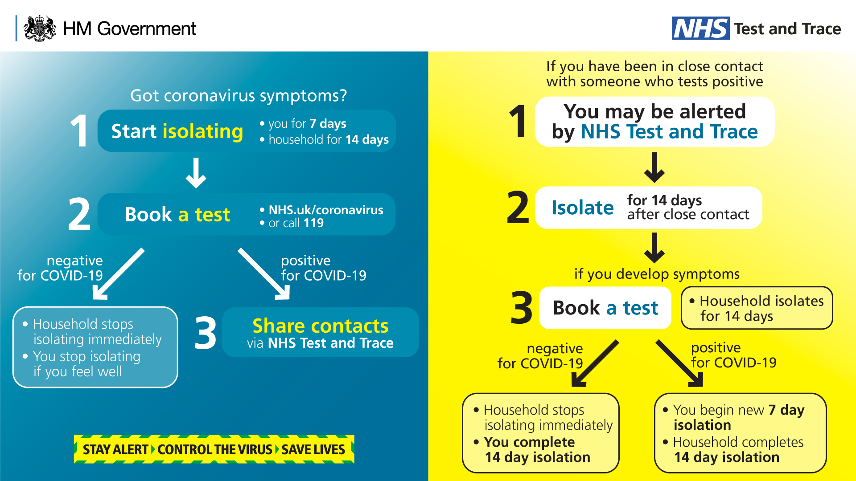
Government
material

Slide 22
Government
material
Government test & trace video

Slide 23
What can you do to help?

Slide 24
Any further questions?

Slide 25
Thank you for
joining us today
The PowerPoint, Q&A and information sheets will be circulated by KCSC – please share far & wide!

Slide 26
Contact details
Carrie Hirst
carrie.hirst@nhs.net
Engagement & Partnership Manager
West London CCG
Lesley Derry
lderry@westminster.gov.uk
Community Champions Programme Manager
Public Health - RBKC & WCC

