Slide 1
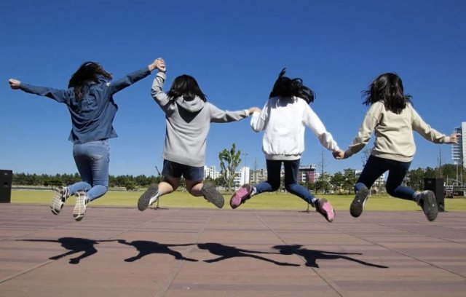
A New Summer Opportunity
We are seeking Expressions of Interests for The Holiday Activity Fund Programme over Summer 2022
The Holiday Activity Fund Programme is a DFE initiative that provides activity and food provision for children aged 4- 16 eligible for Free School Meals during the Easter, Summer and Christmas Holidays.
Applications OPEN on the
10 May 2022
The CLOSING date is the
22 May 2022
For more information about the DfE requirements, please visit:
Holiday activities and food programme 2022 - GOV.UK (www.gov.uk)
If you are interested and would like to submit an application, please complete this form:
https://forms.office.com/r/hcygTdE4Tf
If you would like more information about the opportunity, please contact sbegum8@westminster.gov.uk

