Slide 1


Intro page
What is digital exclusion?
We know that digital exclusion is a reality that a lot of people in our community face. They face barriers such as a lack of:
motivation or confidence to be online and fear for their safety online
the necessary digital skills
access to a device
access to connectivity and necessary data to use the internet
Digital Inclusion means that people can use and benefit from the internet to meet their needs and make the most of the online world
K&C Digital Inclusion Partnership
More than the sum of our parts: The K&C Digital Inclusion Partnership connects all the local organisations who are working with digitally excluded residents so that we can share knowledge and lessons learnt, collaborate, solve problems together, target and plan interventions and realise our vision of no one left behind.
How we work: We meet together at 10am on the last Tuesday of the month in Microsoft Teams – all partners are encouraged to share what you are working on, seek support for challenges you are facing, and share successes that others can learn from!
Sign up to the Newsletter : https://pages.comms.rbkc.gov.uk/p/digitalinclusion
The RBKC Digital Inclusion team has put together some top tips and resources to help organisations in their efforts to support digitally excluded residents:
Resources for your team: slide 2 & 4
Resources to support residents: slide 3
https://www.kcsc.org.uk/networks-and-forums
Title and blurb for the tile
K&C Digital Inclusion Partnership
Get Online in K&C
Monthly cross-sector meeting bringing together local organisations supporting digitally excluded residents, to share knowledge and lessons learnt, collaborate, solve to ensure no one is left behind.

Slide 2

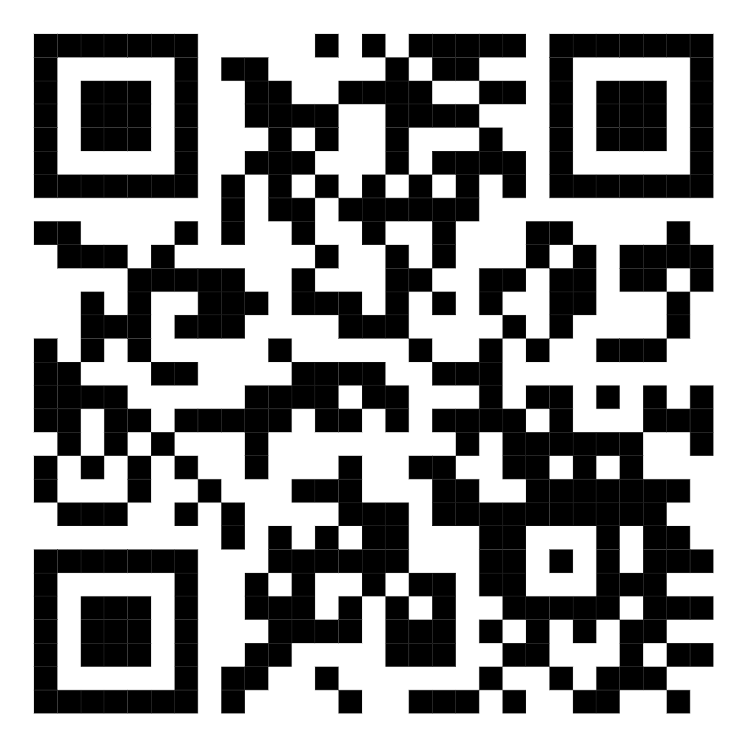
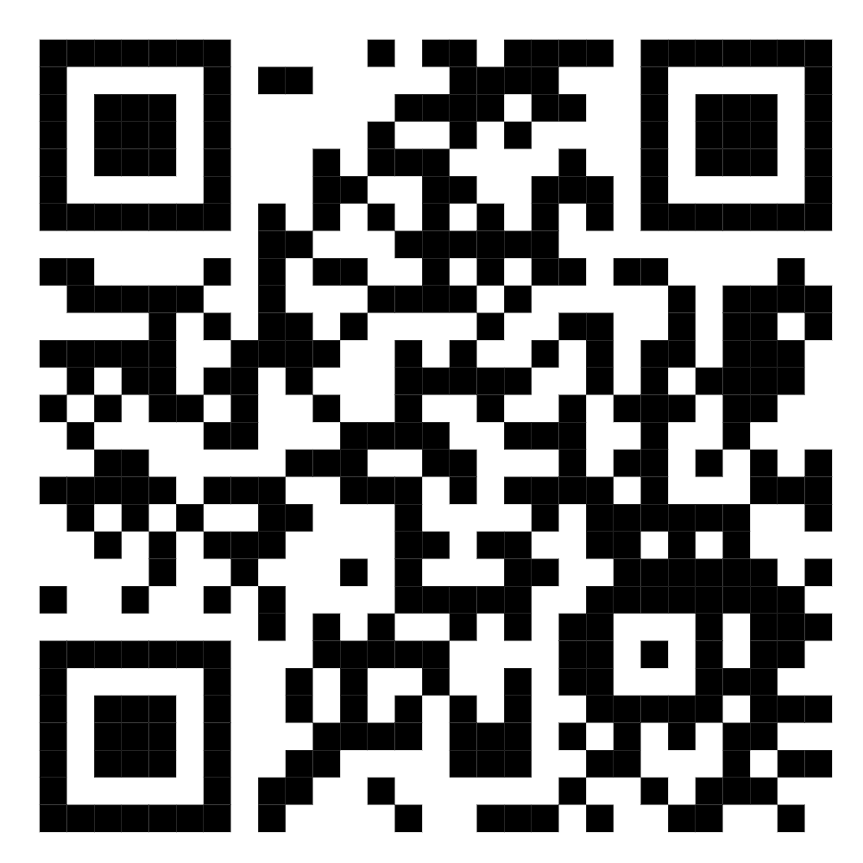
Top FREE resources to help your community get online
A guide to quickly boosting your digital support
Recognising digital exclusion
How much of your time is spent helping people in your community to fill in online forms? Identifying who needs what digital help and the barriers they face is key to unlocking support to develop the digital confidence and meet more of their own needs online.
The Helping Residents Get Online in K&C Handbook has been produced by the RBKC Digital Inclusion Team to raise awareness of what digital exclusion can look like and the sorts of help available. (pdf provided to upload as a downloadable file)
Signposting people to help & support
Webpage: Getting Online in Kensington and Chelsea
www.rbkc.gov.uk/help-to-get-online easy access to:
Digital Inclusion Support Brochure – Download and make sure you have a printed copy at hand. RBKC Digital Inclusion team produces this to help staff and residents find help to get online.
Digital Helper Drop-in Support Map interactive map to locate support
RBKC Digital Inclusion Helpline - 020 7361 2080 – For residents struggling to access online council services, please refer them for support to the dedicated helpline
Get Online in K&C
Connecting to Opportunities
RBKC Digital Inclusion Partnership
Multisector local partnership connecting organisations working with digitally excluded residents, sharing knowledge, collaborating to ensure no one is left behind. This section is now included in the first page
Sign up to the Newsletter : https://pages.comms.rbkc.gov.uk/p/digitalinclusion
Have the monthly meetings in your calendar 10-11am last Tues of every month
Get Online London is London’s first Digital Inclusion service, supported by the Mayor of London and the London Office of Technology and Innovation (LOTI). Join their peer support community on their Basecamp online forum and get advice and guidance from other organisations across London : www.loti.london/projects/diip
Sign up Partnership Newsletter

Slide 3
Resources to support residents:
More support listed in the Digital Inclusion Support Brochure
Digital Skills & Support
IT Help sessions at Libraries Friendly help and support with using the internet, apps, emails, video calls, printing, online shopping, social media, and much more.
Tuesdays, 10am to 12pm - North Kensington Library
Tuesdays 10am to 11.30am - Kensington Central Library
Tuesdays - 2pm to 3pm - Chelsea Library
Thursdays - 1pm to 3pm - Brompton Library
The DigitALL Project: Beginners skills provision with a personalised support plan. Must be 50+ to access the project at Open Age or Midaye, 55+ for Age UK K&C. Adults with a learning disability can access the project at Equal People Mencap. Participants can also self-refer – phone 07570428756 or email nreilly@openage.org.uk to speak to Niall.
Learn My Way: An online programme offering free bitesize digital learning. Allows learners to pick and choose content to meet their needs. It covers basics like using devices, going online, safety, email, social media, and managing health and money online. www.learnmyway.com
Technology Guides by Digital Unite: Written by subject matter experts and updated regularly, the guides are perfect for supporting others with digital skills or improving your own knowledge. Now also includes a section of specially prepared Easy Read guides! www.digitalunite.com/technology-guides
Connectivity
Free SIM cards & Mobile Data for residents:
Virgin Media O2 Stores – Residents can pop into any of their stores and ask for the National Databank. O2 staff will be able to provide eligible residents with an O2 SIM card with 25GB of free data and will receive advice on how to top up for free for the next 6 months.
Money Cafes across the borough provide these to eligible residents. https://www.citizensadvicekc.org.uk/rbkc-money-cafes
Low-cost Broadband and Mobile tariffs - A social tariff is a reduced cost package, offered by broadband and telecom companies to eligible benefit claimants. On average, these tariffs could be saving you up to about £200 annually. Each company has its own list of eligible benefits for these reduced cost tariffs, but all include Universal Credit. www.ofcom.org.uk/phones-and-broadband/saving-money/social-tariffs
Devices
Free computer access at all Libraries: You will need to become a library member.
Free devices for high need individuals: The RBKC Digital Inclusion Team are sometimes able to secure recycled devices. If you are aware of a need for device please email DigitalInclusion@rbkc.gov.uk and the team will let you know if devices are available
Notes:
Digital Inclusion Toolkit
This toolkit is a collaborative resource for local councils and other organisations tackling digital exclusion Sign up to their newsletter to receive national updates www.digitalinclusionkit.org/news

Slide 4

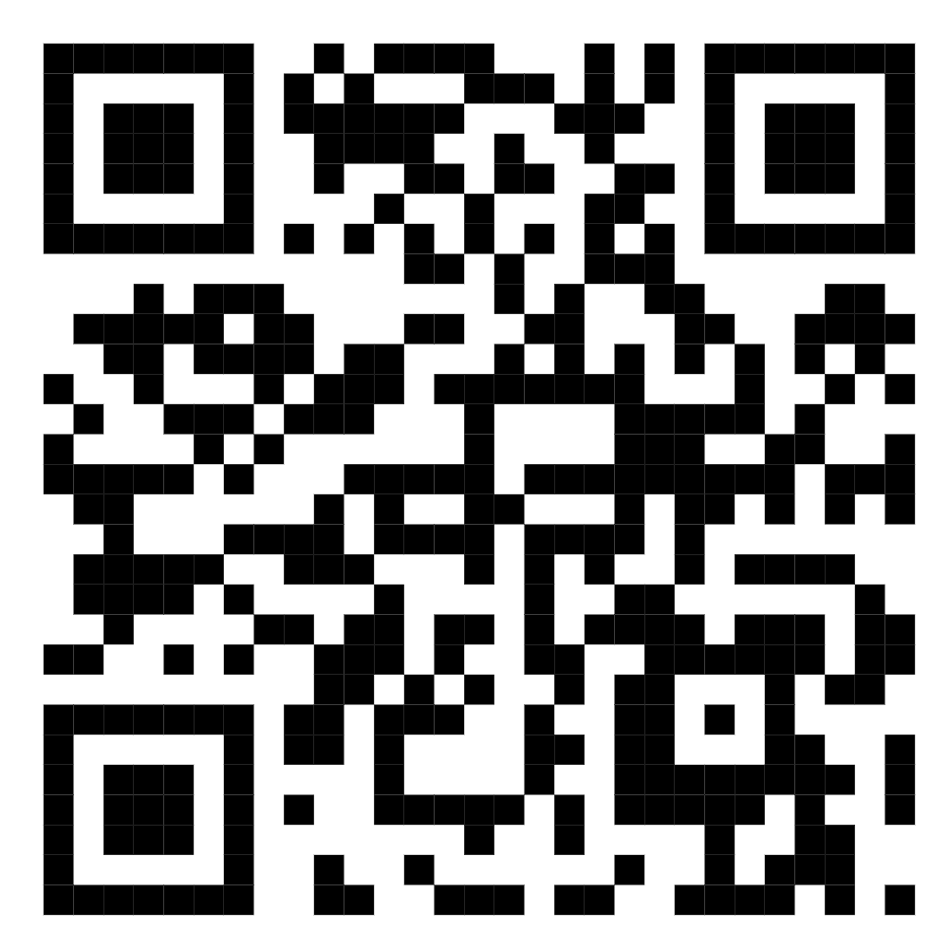
Join the National Online Centres Network!
Sign up on www.goodthingsfoundation.org/network
The Network is run by the leading national digital inclusion organisation Good Things Foundation and brings together f third sector organisations, libraries, community centres, NHS services, public sector departments and food banks - all working together to support people who are excluded from the online world.
Why Join the Online Centres Network?
By becoming a member of the National Digital Inclusion Network, your organisation will gain access to a wealth of resources and support to help you deliver free digital inclusion services to your community. Here are some of the benefits:
Free Mobile SIMs: Through the National Databank, members can offer free mobile data to help people get connected.
Free Refurbished Devices: The National Device Bank provides free laptops, tablets, and other devices to those who need them.
Free Digital Skills Training: The Learn My Way programme offers free digital skills learning to help beginners get online. www.learnmyway.com
Grant Opportunities: Members can apply for digital inclusion grants from the Fix The Digital Divide Fund to support their initiatives.
Peer-to-Peer Networking: Connect with other community organisations and share experiences and advice.
Regular Training Sessions: Participate in online training sessions co-delivered by experienced members.
How to Join
Joining the National Digital Inclusion Network is easy! If your organisation is a registered charity, community interest company, social enterprise, community benefit or cooperative society, you can start your application today. NHS Trusts and other public services are also welcome to join.

