Slide 1


KCSC MCMW
Delivery
REPORT 2024-5
This report gives details of the referrals and delivery on the MCMW programme over the year

Slide 2
My Care My Way
Patients must be over 65 and have long standing health conditions that affect daily life and be on the MY Care My Way programme that are capable of management with self-care activities
The programme offers other support beyond the self-care programmes delivered through KCSC
GPs (or Case Managers) refer / add suitable patients to the programme
There is a wider review of the MCMW programme but this has not concluded.

Slide 3
Available services
There are 13 (or 16) services available from 5 providers
The current contract ends at the end of March 2024
A new contract will run for one year from 1st April 2025 with most of the same services – with the loss of 2 providers
Occiaisionally services will pause referrals

Slide 4
Available Services
Physical & emotional wellbeing
☐ Link-up into Open Age supporting people into ANY of Open Age's activities (This includes Steady & Stable, Healthy Lungs, Zumba, language classes, Arts, Social groups, language classes, Singing to name a few! This is done by building rapport with the person referred and identifying interests and any barriers to participation.
☐ Men's Space @ Open Age supporting men to engage in Men’s activities and wider Open Age programme as part of improving their own health and well-being. Building rapport and confidence. 9 sessions
☐ Chair based Exercise and Walking Support (combined service) supports people at home who are struggling with their mobility and strength. Practitioner will visit, assess, and deliver 6 weekly sessions at home. The sessions combine both chair exercises and walking outside, weather permitting. 6 sessions per referral.
☐ Massage at Centre massage/reflexology provided at local venue (subject to available space). 6 sessions.
☐ Massage at Home massage/reflexology provided in patient’s home. 6 sessions.

Slide 5
Dementia support
Dementia 1 to 1 Support – Assisting people with a confirmed diagnosis of dementia to live better with dementia by providing relevant information around their diagnosis, supporting them to access activities and/or day centres, provide cognitive activities at home and develop techniques to maintain independence. Actively work with the client to ascertain their likes, dislikes and or wishes through life story and memory work. 10 sessions. Patients must have a confirmed diagnosis of dementia to be referred.
Practical Support
Information and Advice Over the phone or face to face - Advice, casework, and support around maximising income through benefits, grants and utilities, help with housing and social care and assistance with transport options. Up to 4 Sessions per referral. 2 referral limit does not apply. Two providers:
  Age UK
  Westminster CAB
Escorting Supporting patients with mobility problems to get to medical appointments, shopping, social engagements etc. 4 sessions per referral.
Light De-cluttering Help relocating items to a safe place in the home, tidy up draws, sort papers. It is not appropriate for hoarding referrals. The service does not remove or relocate large items. 6 sessions.
Link-up into tech Open Age service to help people on a 1 to 1 basis to increase their knowledge about their device and to increase their technological skills accessing and downloading Zoom and other suitable platforms. Available in English or Arabic. 1 or 2 sessions.
Carer’s Respite 2-hour breaks for older carers to have a break from caring and do something for themselves. They can stay in the home, or they can go out. This does not count as one of the patient’s 2 referrals. 6 sessions per referral.

Slide 6
☐ Befriending one to one service that offers emotional and social support and encourages attending activities in the community to alleviate social isolation – 6 sessions per referral.
New services from July 2024
Support in Community languages
  A patient will be referred for a series of 6 sessions with a designated worker in one of the four languages below, the patient may receive any of the activities listed below during their sessions:
  Befriending / emotional support in their language,
  advice and information including form filling and benefits and income maximization,
  assistance in making and attending appointments, and support in accessing social activities.
6-8 sessions per referral in these languages:
☐ Arabic (Egyptian)
☐ Farsi
☐ Somali
☐ Spanish

Slide 7
Referrals and delivery

Slide 8
What happens to referrals
Around a third of clients referred do not go on to receive the service - a significant number change their mind or do not respond to contacts, but around 10% referrals are not appropriate for the service. These numbers have been consistent for the last few years

Slide 9
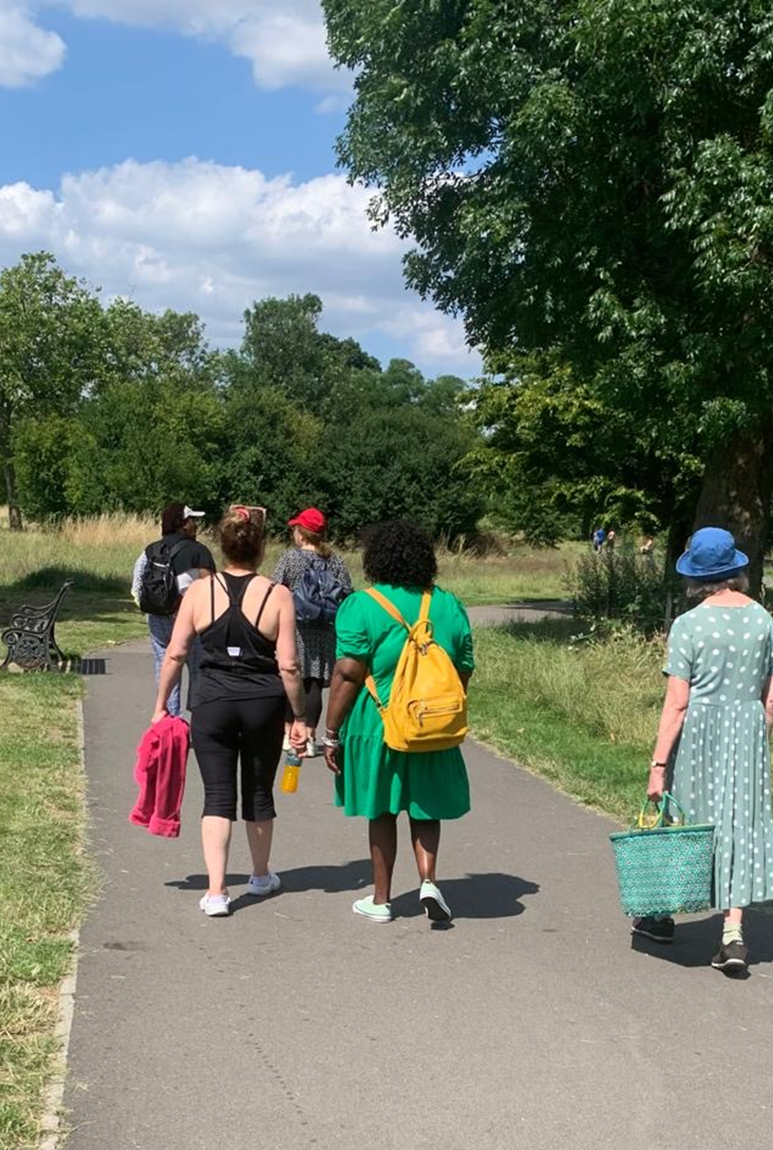
90%
OVERALL SATISFACTION
Most respondents found the sessions beneficial and rated the quality of service highly
38%
0%
0%
25%
0%
0%
13%

Slide 10
Demographics

Slide 11
Demographics
Communication about contract renewal
Most of these reflect delays from funder rather than KCSC

