Slide 1
The role of the VCS in Integrated Neighbourhood Teams (INT)
What are they? What is our role?

Slide 2
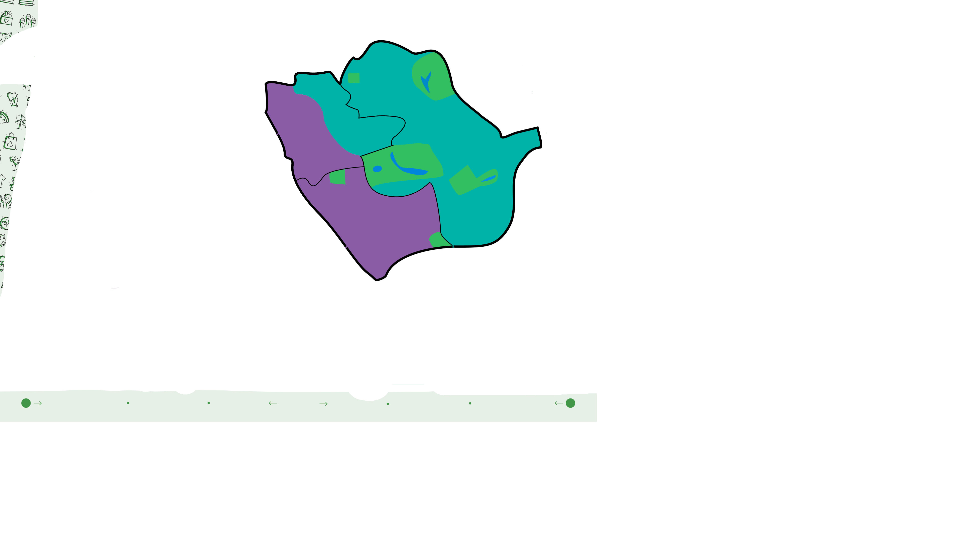
Introduction to INT
Westminster/ Central INT
North INT
(North K&C and QPP )
South INT

Slide 3
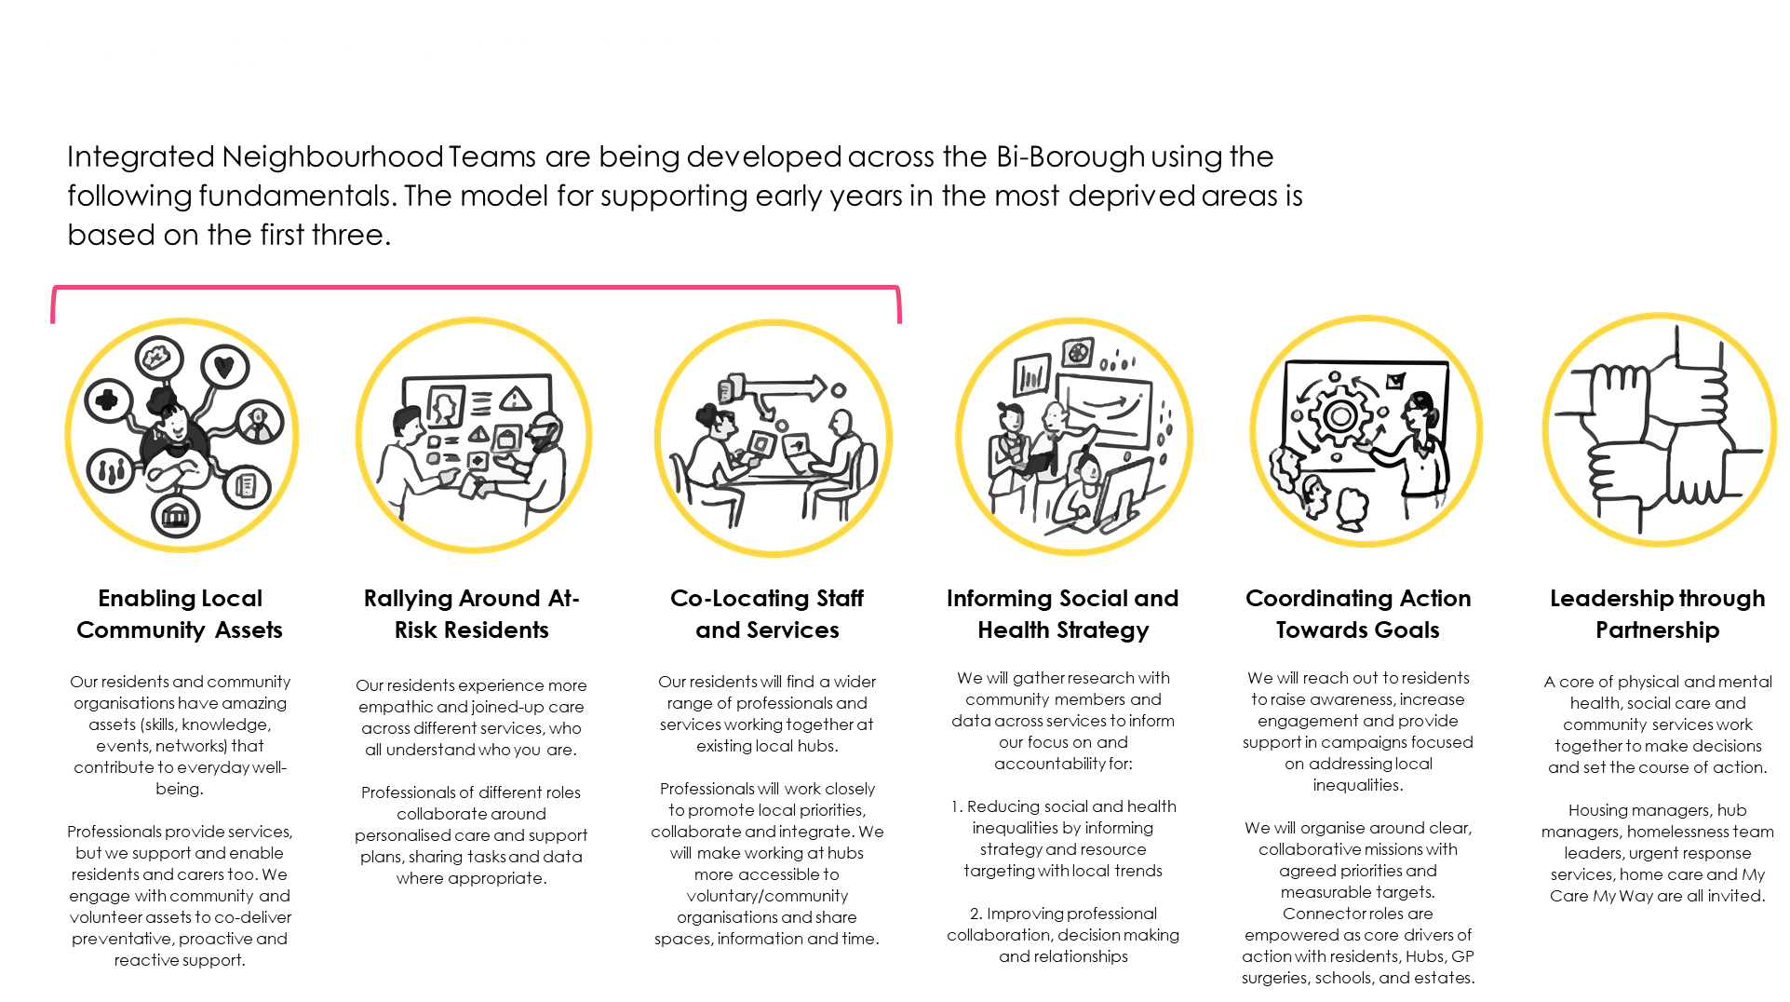
Introduction to INT

Slide 4

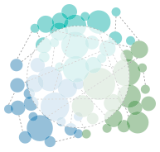
Introduction to INT
‘We are bringing together local services across health, social care and community groups to support better health and wellbeing in our neighbourhoods. We know what a difference we can make by working together, especially for those living with complex social or health conditions.’
community sector
over the next 10 years
INT enabling
culture & connectivity
health sector
social sector
Social, community and health organisations are aware of each other and sometimes collaborate, but are not deeply integrated. Residents and staff know this experience too well.
We want to enable organisations
to work in more integrated ways, and to collaborate on more ambitious outcomes with and for our residents.

Slide 5
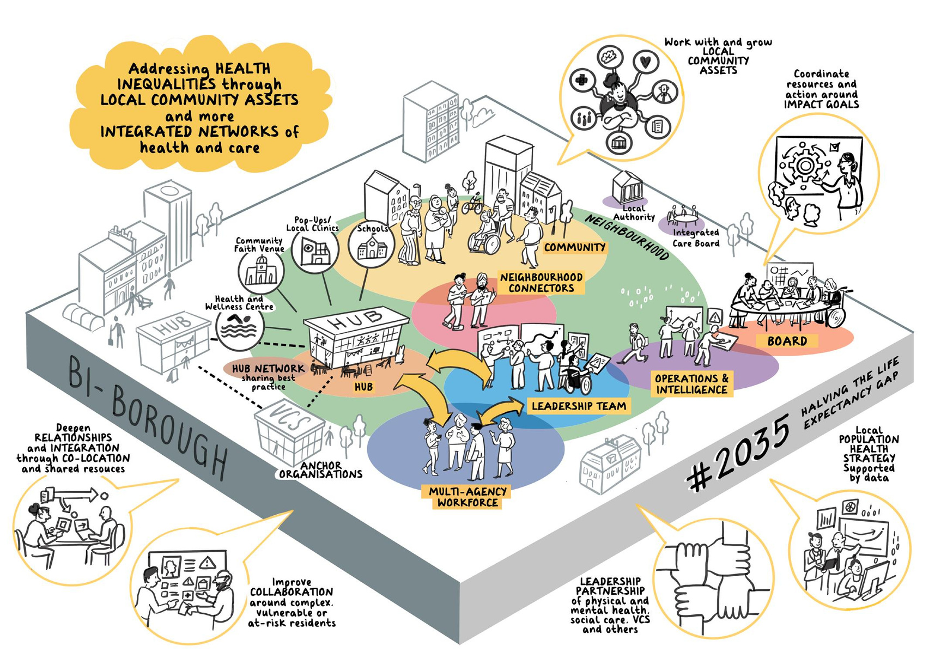

Slide 6
INT Steering Group
North INT
West INT
South INT
Delivery/Sub-Groups
Delivery/Sub-Groups
Delivery/Sub-Groups
Delivery/Sub-Groups
Delivery/Sub-Groups
Delivery/Sub-Groups
Delivery/Sub-Groups
Delivery/Sub-Groups
Delivery/Sub-Groups

Slide 7

North INT
(North K&C and QPP )
Highlights
Priorities
  My care My Way Review (MCMW)
  North Kensington Recovery
  Older Persons Mental Health
  Estates
  Co-production
  Comms & Engagement
  Data & Analytics
The North INT is chaired by Jo Reeder - Assistant Director, Integration and Delivery West London (NHS NWL)
VCS Representatives
  Jess M (Age UK)
  Iain C (Open Age)
  Liam P (KCSC/One Westminster)
A My Care My Way Review sub-group has been established to review the service. This sub-group will bring all sectors delivering the programme together to;
  Create a narrative on how the services supports older people
  Improve efficiency and integration between services
  Develop an improved delivery mechanism
  Address levels of access inequality
  Make recommendations on how MCMW can be used as an operating model across North West London INTs
An Older Persons Mental Heath Outcomes Framework sub-group has been established by the North INT. This group will take a population health management approach to identify the needs and desired outcomes for older persons mental health. A series of workshops to commence this process has been scheduled from March - April 2024.

Slide 8

South INT
Highlights
Priorities
  Children, young people and families
  Navigation Role Mapping
The South INT is currently led by Joe McGale - Assistant Director Primary Care (NHS West London Commissioning Group)
VCS Representation
  Angela S (KCSC)
A Navigation workstream has emerged in the South INT to map and establish a network of navigation roles in the south of the borough. 2 workshops will take place (second in February 24 with navigation workers) with the intention of fostering more collaborative working, improving early intervention and supported self-management and identify future development/training needs.
A children, young people and family sub-group has been established to explore the needs in the south of the borough. Target have been set, which include;
  Access to primary care for 12-17 year olds
  Better utilising CNWL children’s mental health workers
  Poor dental outcomes/lack of accessing services
  Childhood obesity
  Complex needs

Slide 9

Westminster INT
Highlights
Priorities - The Westminster INT is still to agree specific outcomes, but has a broad focus on;
  Long Term Conditions
  Access to services (HIU)
  Octopus & Just Listening
  0-5 Years (Family Hubs)
Westminster INT is a continuation of the demonstrator group with many work streams (such as Octopus) continuing in the borough. The Westminster INT is chaired by Lalita Scott (Transformation Programme Director - Healthcare Central London (HCL) and supported by the VCS with Jackie (One Westminster) and Liam (KCSC/One Westminster)
The Octopus Programme seeks to develop a network of connector roles across Westminster to address wider social determinants of health, focused on a relational and trust based approach among roles and the wider health and community sector in the borough. Large events are held regular to collaborate and discuss solutions to issues in the borough.
The 0-5 years demonstrator work is focused on a Integrated health and wellbeing offer, building on the Family Hubs offerings and adopting locally focused outreach. Collectively, we work to ensure that children are school ready by the age of 5, and have foundations for a happy, healthy and resilient life.

Slide 10


What is our role and how do we influece?

