Slide 1
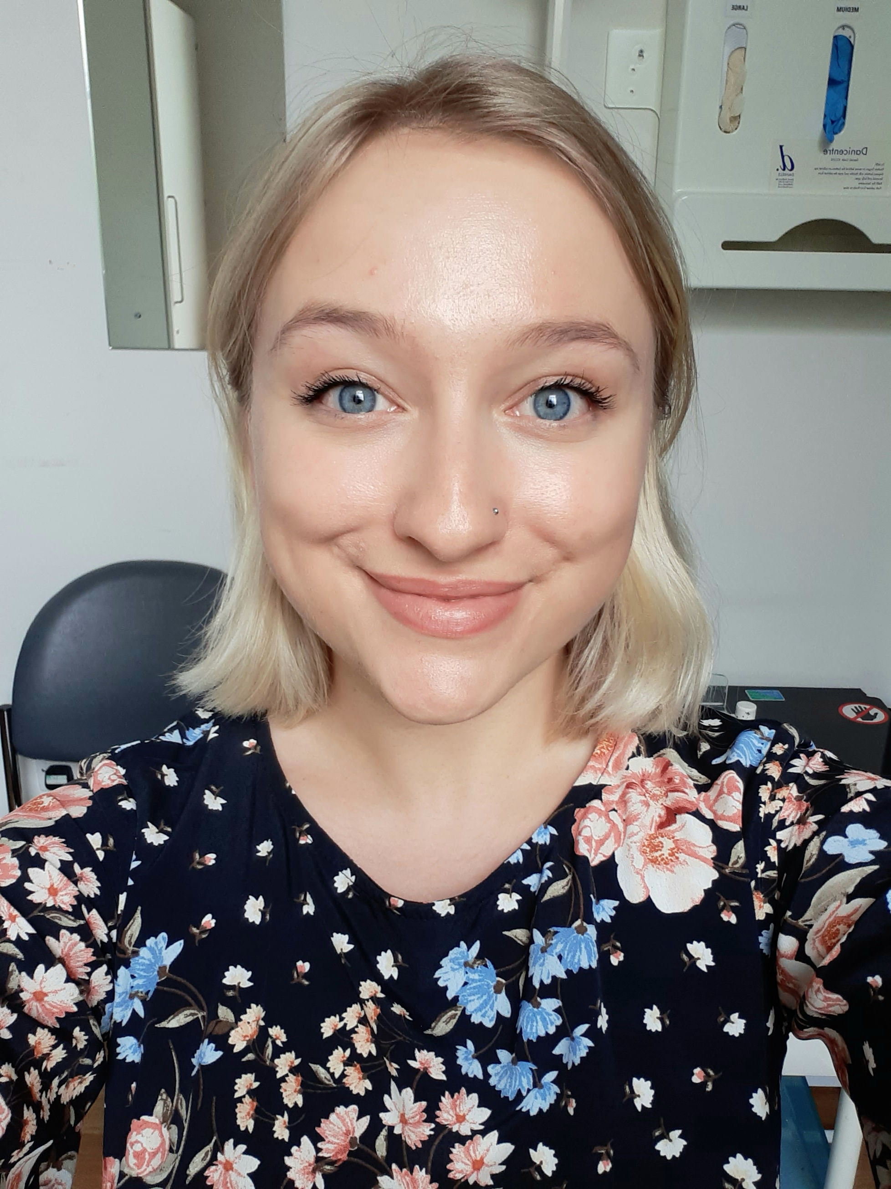
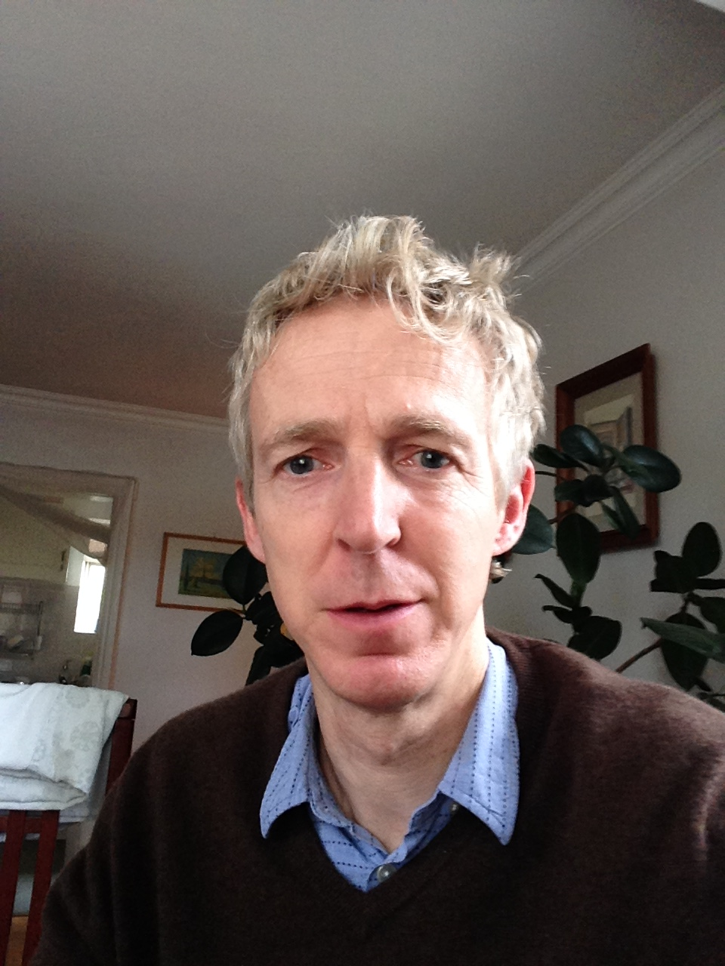
Social Prescribing Link Workers
NeoHealth PCN
Barnabas (Barney) Palfrey Jaslin Seehra Julia Hamilton
North Kensington SPLW
Notes:
Julia introduction

Slide 2
How can people use our service?
People must go through their GPs if they would like social prescribing
Services cannot refer to us yet
Must be 18-64
What can we offer?
More time than GPs to listen and help people decide what they’d like to do to improve their health, wellbeing and independence
Help to find and access activities, services or specialist support
Support for anything up to 6 months or a year, as appropriate
We want to link people with you!
Notes:
Julia

Slide 3
How can people use our service?
People must go through their GPs if they would like social prescribing
Services cannot refer to us yet
Must be 18-64
What can we offer?
More time than GPs to listen and help people decide what they’d like to do to improve their health, wellbeing and independence
Help to find and access activities, services or specialist support
Support for anything up to 6 months or a year, as appropriate
We want to link people with you!
Notes:
Barney

Slide 4
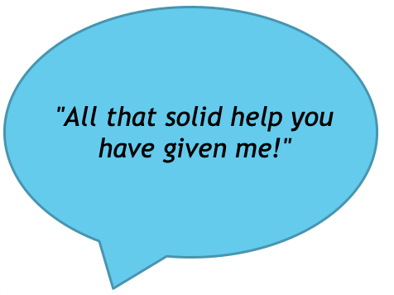
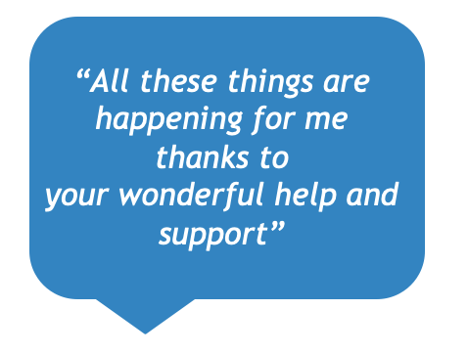
What have people said about us?
"I honestly don't know what I would have done without your being here to support me these last weeks."
Notes:
Jaslin

Slide 5
Case Study - Jaslin
A patient in late 30s cancer survivor, Hodgkin's disease, depression, endometriosis, asthmatic, Shielding, short temper, carer for mother.
Initial call:
Stated 'would kill herself' but would not act on it, 'tired mentally & physically'.
Discussed previous interests prior to cancer.
Changes from 2 SP sessions:
Enrolled Age UK photography class, now looking at other classes.
Encouraged shielding Mother to join a 'Learn English' class
Started baking at home
Increased fruit intake
Referral actioned from CLW for counselling.
Feedback:
Mind diverted from thinking 'pain, pain, pain' to now ' thinking of different ideas to submit for photography homework - something new to introduce my thoughts, normally takes time for medication to kick in, this was instant gratification'.
' thank you for encouragement, it's been hospitals & Dr's nonstop, I haven't done anything like this in over 12 years'.
Notes:
Jaslin

Slide 6
Case Study - Barney
Mid-50s woman with chronic complex fibromyalgic pain
wheelchair user with daily carer; chronic depression.
8 contacts since mid-May - 7 phone calls, 1 home visit; plus some emails
Carer letter from GP Surgery to jump supermarket queues during lockdown,
NHS psychotherapy chased after ceasing suddenly upon lockdown;
Homecare charges dispute resolved
Pt’s social isolation and lack of positive stimulation
check-in-and-chat calls from Life in Balance
enrolled in Zoom English conversation classes with Nova;
during home visit, the pt showed things she had made, and we discussed art/craft courses at Morley-KCC.
Massage gives her real pain relief -- Waiting for North Ken GPs massage offer (Oct 2020?)
Carer hours are inadequate -- but nervous to re-open this question with Social Services
Next Steps: - plan with pt ceasing of my temporary involvement – more ideas/goals?
Notes:
Barney

Slide 7
Case Study - Jaslin
Pt late 20s – depression, anxiety, asthma, obese, financial difficulties, lives w/ wife from overseas (main carer) & young baby, high debt
Initial:
'Want to lose weight, but shy & high anxiety of everyone judging me in the gym'
' Stressed and bored at home, nothing to do for my family'
Actions:
Referral to One You – weigh management support
Swimming K&C leisure centre – take wife & baby (family approach, < anxiety)
Investigate PIP for mobility scheme & personal allowance
Support from CBT therapist from CLW for anxiety
Offered SP to wife – but declined – will find family grps instead
Notes:
Jaslin

Slide 8
Case Study - Barney
Late 50s woman, survivor of breast cancer, with anxiety and fatigue,
worried about her two sons in early 20s living at home in small flat
5 contacts since early August - 3 phone calls, 1 walk outside and 1 home visit
Younger son with adult ADHD; older son has slipped into depression at home since finishing university
All found COVID lockdown very stressful and anxious
Covid anxiety "… of course, I don't go outside..."
Isolated since her illness
Likes idea of Helpforce Companion to go out on weekly walks with her
Volunteering? -- Re-engage with Meanwhile Gardens projects?
Next Steps: - continue to work with mother and son, and hopefully the depressed son also
Notes:
Barney

Slide 9
The North Kensington SPLW Role
What is different?
Taking patients from the wider community beyond the Dedicated Service whose issues appear to stem from the Grenfell fire
More time to get to know and support VCSE organisations in the area
Using experience with patients to identify and fill gaps in the VCSE sector, working closely with KCSC
Examples of patients
Mother in her late thirties, son suffering from PTSD and night terrors due to Grenfell, mother feels she cannot look after her own health and wellbeing
Woman in her mid-fifties who lost friends in Grenfell, feels anxious, isolated and disconnected from the community
Notes:
Julia

Slide 10
The North Kensington SPLW Role
What is different?
Taking patients in the wider community beyond the Dedicated Service whose issues appear to stem from the Grenfell fire
More time to get to know and support VCSE organisations in the area
Using experience with patients to identify and fill gaps in the VCSE sector, working closely with KCSC
Examples of patients
Mother in her late thirties, son suffering from PTSD and night terrors due to Grenfell, mother feels she cannot look after her own health and wellbeing
Woman in her mid-fifties who lost friends in Grenfell, feels anxious, isolated and disconnected from the community
Notes:
Julia

Slide 11
Thank you for listening!
Any questions?
Barnabas (Barney) Palfrey – barnabas.palfrey@nhs.net
Jaslin Seehra – j.seehra1@nhs.net
Julia Hamilton – julia.hamilton2@nhs.net
Notes:
Julia

