Slide 1
North Kensington Health & Wellbeing Network
14 October 2020, 10.00am – 11.30am

Slide 2
MEETING GROUND RULES
We have put together some ground rules in order to run this online meeting:
Please mute your microphone throughout the meeting unless you have been asked to speak.
Please write your name and organisation in the chat window.
If you would like to ask a question during a presentation, please write this in the ‘chat’ window.
If you would like to speak, use the ‘raise your hand’ button or write HAND in the ‘chat’ window and someone will let you know when you can speak.
A brief feedback form will be posted at the end of the meeting which we would ask you to complete. Thank you.
Please let us know if you have questions about any of the above.

Slide 3
AGENDA
10:00AM – 10:05AM – Welcome - Hayley Turner, Health & Wellbeing Manager, KCSC
10:05AM – 10:15AM – Introduction from Self-Care/Social Prescribing GP lead - Dr Meena Nathan
10:15AM – 10:25AM – Outline the Aims and draft Terms of Reference of the Network
10:25AM – 10.55AM – Self-Care and Social Prescribing – Kalwant Sahota, Self-Care & Social Prescribing Manager, WLCCG (including Social Prescribing Link Workers and an Example of Social Prescribing in practice)
10.55AM – 11.10AM – The new North Kensington Self Care Programme (including Current Focus and Partnerships/Funding)
11.10AM – 11.30AM – Networking

Slide 4
Introduction from Self-Care/Social Prescribing GP lead Dr Meena Nathan

Slide 5
MEETING AIMS
Share experiences, resources and reduce overlaps in services and enable us to work more effectively together to meet the health & wellbeing needs of residents in North Kensington.
To provide up-to-date information on the wider health and wellbeing agenda and how it relates to North Kensington.
To explore initiatives that might lead to joint bidding for funding and contracts.
This network has been set up as part of the NHS North Kensington Health and Wellbeing Strategy and is a joint partnership with WL CCG.

Slide 6
TERMS OF REFERENCE

Slide 7
Self-Care and Social Prescribing Kalwant Sahota (Self-Care & Social Prescribing Manager, WLCCG)

Slide 8
North Kensington Health & Well Being Forum
Self-Care and Social Prescribing
Kalwant Sahota
Self Care and Social Prescribing Manager

Slide 9
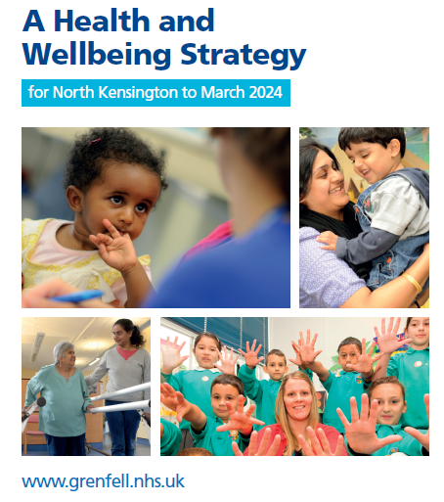
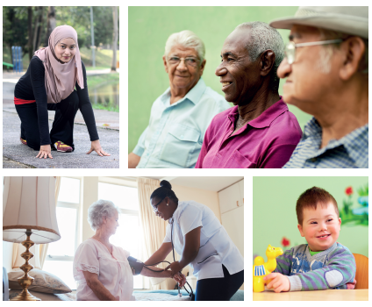
Health and Wellbeing Strategy for North Kensington
Notes:
The strategy outlines the continued commitment from the NHS to support the improving health and well being of communities, through building resilience within North Kensington.
Key feedback has been ‘we are a family’ so want to be treated as a family; help local community to build their own capacity so they can look after themselves; support as a whole community.
We know within North Kensington there are long standing health inequalities with poorer physical health and mental wellbeing i.e. diabetes; mental health; obesity; hypertension and depression.
Under the strategy there is a commitment for self-care in ensuring access to non-medical activities and services in the community. Programme of self care such as Maxilla Men’s Shed, Yoga, Health Coaching and Mind, Body and Breath training. As out next steps we have set up this forum as part of the menu of services and commitment to respond to local need.

Slide 10
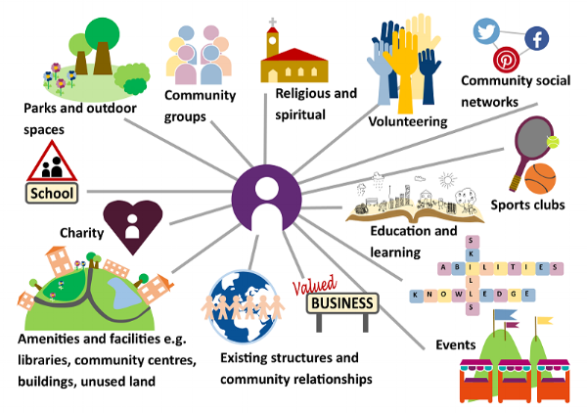
What is Social prescribing
https://www.healthylondon.org/our-work/personalised_care/social-prescribing/
Notes:
Social Prescribing is nothing new and has been offered in different formats over many year.
Many things affect a persons health and well being, such as finance, social connections and environment. Often I have patients telling me they are lonely, feeling isolated, stressed, having money worries or problems with housing issues. These cannot be fixed by medicine alone, in London 20% of patients consult their GPs for social problems. Often a patient needs a service which does not come in a bottle or a tube.
Basically social prescribing is to enable a patient to have more control over their healthcare and manage their needs in a way that suits them.
It often starts with a conversation with a link worker, support broker, community navigator and in the case of your local NHS here at West London CCG that could be your health and social care assistant, case manager or community living well or your local GP receptionist. They listen and find out what the real issue is and connect you to services to your need. That might be a community group, new activity, lunch club, local choir, reading group, legal advice, local gym, walking club and others. This would very much depend on the individuals situation and what was on offer locally to them.
Studies clearly show that to get better and feel better does not come from medicine alone. Evidence shows that working in this way it could lead to a 25% reduction in A&E attendance and a 27% reduction in GP visits.
Traditionally healthcare has been provided by health professionals, such as doctors, nurses, and occupational therapists based in a range of NHS settings including primary care. People’s health and their ability to manage it are influenced by a wide range of factors beyond the scope of these professionals’ practice. Such factors include employment, housing, debt, social networks and culture which have been estimated to account for 57% to 85% of the determinants of health status

Slide 12
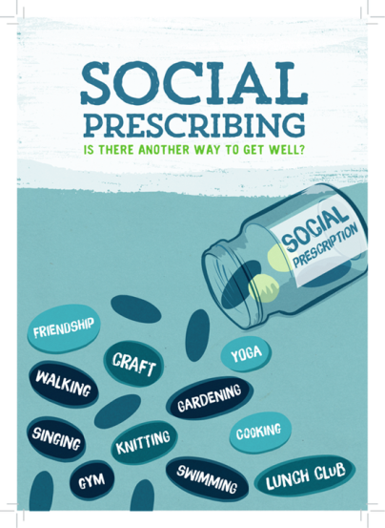
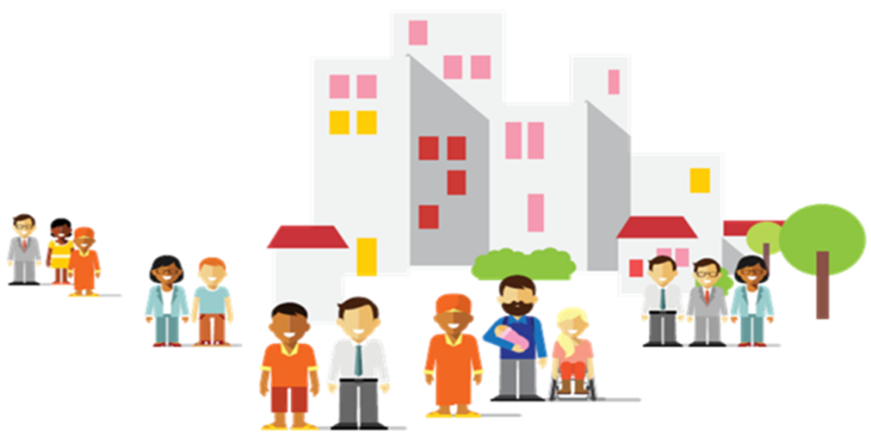
Social Prescribing in West London CCG
Notes:
Social prescribing is one of the core elements of the My Care My Way MCMW service. The MCMW service being one of the central pillars of the Integrated Care Team. This service has been evolving as an integrated care system since 2014. WLCCG is recognised as one of a number of national “Pioneer” providers of “Whole Systems Integrated Care” WSIC.
WLCCG has one of the most sophisticated and mature social prescribing systems in the UK. There are more than 100 schemes currently running in the UK, and more than 25 of these are in London.
Key points for social prescribing in WLCCG
It aims to address people’s needs in a holistic way
It contributes positively to patients’ confidence, motivation and resilience (increasing “Patient Activation” captured in the PAM Score)
There is evidence of a long-term reduction in use of GP and Hospital appointments
Iraises awareness of the enormous range of activities and services provided by the “Third”/Voluntary sector (including: arts activities, social groups, learning activities, gardening, befriending, healthy eating, advice and a range of appropriate sports)
Kensington and Chelsea Social Council (KCSC) manages the self-care menu of services.
Programme of changing self -care activities to help people take more control over their health and wellbeing, build social contact, and help them access community, leisure and volunteering opportunities Accessed through CLW or by self-referral Clement James Wellbeing Programme – The Clement James Centre will continue their activities, groups and learning sessions however these will be delivered through phone calls, video and online sessions.
Well Read – Play reading sessions will continue to be offered online through Zoom on Tuesdays and Fridays.
Emotional 1:1 support in your language – The BME forum offers a support package service available in Arabic (Moroccan and Sudanese dialects), Bangla, Farsi, French, Somali and Spanish. This service will be offered over the phone.
Massage Therapy – Mental Health Unwind sessions are being offered from Thursday 24 September 2020. These include four massage treatments and two online or phone guided meditation or rehabilitation classes.
My Recipe, My Story – My Recipe, My Story is providing support to their current clients. You may register your interest in joining the service for when sessions are back up and running.
Volunteering on Prescription – Volunteering on Prescription are accepting new referrals from people with mental health needs who are registered with a GP in Kensington and Chelsea, Queen’s Park or Paddington. They are offering online/phone Wellbeing workshops (for example Managing Anxiety and Worry, Relaxation Techniques, Healthy Eating and Cook and Chat workshops) where you can join in or just listen. They also have online/phone social coffee mornings and afternoons and quizzes. If you’re feeling isolated, we can match you with a face-to-face or telephone/online befriender volunteer. SPLW – who will be speaking shortly

Slide 13
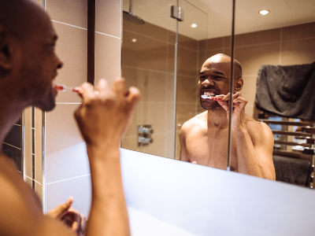
What is Self Care?
Self-care is just what it sounds like: taking care of yourself:
“Self-care is the practice of consciously doing things that preserve or improve your mental or physical health”
Examples of self care?
Why is it important?
Notes:
This question is a little harder to answer, because self-care is different for everyone. It’s about looking after yourself mentally and physically, and everyone has different needs.
Really, anything you do for yourself that makes yourself feel better or cared for can be considered self-care. This could be making sure to floss regularly, it could be taking time to yourself when you need it, it could be getting a new haircut.
The term self-care is also used in the medical community to refer to individuals taking charge of their own health. This includes everything from making healthy lifestyle choices to taking an active part in managing long-term conditions.
Self-care is an important part of living a healthy and happy lifestyle. Looking after yourself both mentally and physically is crucial to taking control of your health.
We lead increasingly busy lives and it can be easy to forget to put yourself first, especially if you have multiple responsibilities and other people to care for. But looking after yourself will make you feel better, and the better you feel, the better you will be in all areas of your life – from work to relationships.
Self-care doesn’t have to involve a huge time commitment and it doesn’t have to cost the earth. It could be taking a bath, relaxing with a good book, taking a walk outside or eating your favourite food. It’s about making a commitment to putting yourself first, even just for a while.

Slide 14
Health services available in North Kensington
Your GP - call to make an appointment, all patients will receive a telephone call back in the first instance but will be called into the practice if needed. You can also book an extended appointment and an Enhanced Health Check through your GP. There is an interpretation service too – called Silent Sounds.
NHS 111 – call 111 or visit www.111.nhs.uk for health advice and to speak to a health professional and find local services.
In an emergency - call 999
Mental health
Grenfell Health and Wellbeing Service – call on 020 8637 6279 or e-mail Grenfell.wellbeingservice@nhs.net.
CNWL single point of access 0800 0234 650
Samaritans 116 123

Slide 16
The North Kensington Self-Care Programme

Slide 17
AIMS
Self-care is a key component of the North Kensington model to improve residents health and wellbeing. Self-Care extends the range of options available to people who present to primary care with health & wellbeing needs and, in doing so, supports them to access services in their local community.
To improve the health and wellbeing of the residents in North Kensington
To promote the benefits of a healthy lifestyle.
Increase access to third sector provision to promote overall wellness.
Provide opportunities for people with underlying medical conditions to become more active
Equip patients with the knowledge and skills to become better managed with their long term conditions.
To promote long-term behaviour change.

Slide 18
PRIORTIES
North Kensington Network
Complementary therapies
Digital exclusion and access to health services
Nutrition & cultural cooking
Improving health literacy
Mental Health First Aid training
Notes:
Digital exclusion and access to health services
Physical space and digital training for helping people access health services like GP appointments, apps, self-care services etc partnership encouraged
15-30
Nutrition & cultural cooking
Virtual cooking, distanced / mixture – adapting traditional/cultural recipes to be healthier – pilot 4-6 organisations £5,000
ESOL for health
Mental Health First Aid training

Slide 19
What other needs are not being met in the North Kensington community?

